Slide 1
Router protocol on wireless sensor network
Yuping SUN 155169552@163.com
SOFTWARE ENGINEERING LABORATORY
Department of Computer Science, Sun Yat-Sen University
51
Notes:
1.Suvery on Routing Protocols of Wireless Sensor Networks
Yuping SUN.
注意写法.
文件名: Y.P. Sun
S.Y.Ping是不正规的
2. 51页可能太多,明天把握节奏.一般30页能讲一个下午.
3.请在参考文献列于当页页尾

Slide 2
Outline
WSN Introduction
  The definition of WSN
  The nodes of WSN
  The difference between WSN and Ad hoc
WSN Routing Protocol
Conclusion
Reference
51
Notes:
introduction不要花太多时间

Slide 3
The definition of WSN
Definition[1]:
  consist of large amount of sensor nodes
  Multi-hop, self-organize
  wireless communication
  cooperative sensing, collection, process
  Send to observe.
51
  [1]李建中, 李金宝, 石胜飞. 传感器网络及其数据管理的概念、问题与进展. 软件学报, 2003 (10) : 1717- 1725
Notes:
aggresion --> aggregation?
如果要给出定义,你可以:
1.引经据典,不然自己的定义是不具有说服力.
2,讲清楚为什么要这样定义.
3.这几点有内在的逻辑关系吗?
4.这几点能把WSN的全貌都表达出来了吗?

Slide 4
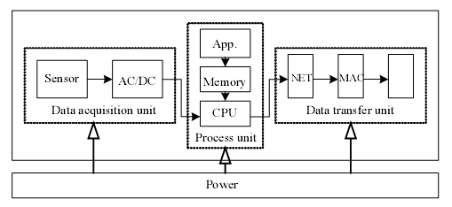
the nodes of WSN
51
Notes:
这一页可以不用介绍了,已经被介绍过很多次.

Slide 5
The difference between WSN and Ad hoc (1/2)[1]
The number of nodes
Sensor nodes are densely deployed
Sensor nodes are prone to failures
The topology of a sensor network changes very frequently
51
[1]Ian F. Akyildiz, Weilian Su, Yogesh Sankarasubramaniam, and Erdal Cayirci Georgia Institute of Technology” A Survey on Sensor Networks” IEEE Communications Magazine • August 2002
Notes:
[1]
Ad Hoc网络是一种没有有线基础设施支持的移动网络，网络中的节点均由移动主机构成。Ad Hoc网络最初应用于军事领域，它的研究起源于战场环境下分组无线网数据通信项目
MANET(mobile ad hoc networks)是一种可以根据需要随时快速搭建的无线网络,不需要任何基础设施的支持.

Slide 6
The difference between WSN and Ad hoc (2/2)[1]
WSN broadcast but ad hoc point-to point
Sensor node are limited in power computation capacities and memory
Sensor nodes may not have global identification
51
Notes:
请指明引用出处

Slide 7
Outline
WSN Introduction
  The definition of WSN
  The nodes of WSN
  The difference between WSN and Ad hoc
WSN Routing Protocol
Conclusion
Reference
51
Notes:
introduction不要花太多时间

Slide 8
Routing protocol survey
Traditional technique
Flooding
Gossiping
Current routing technique
Flat-routing
Hierarchical-routing
Location-based routing
51
[1]Ian F. Akyildiz, Weilian Su, Yogesh Sankarasubramaniam, and Erdal Cayirci Georgia Institute of Technology” A Survey on Sensor Networks” IEEE Communications Magazine • August 2002

Slide 9
Flooding(1/2)
A classical mechanisms to relay data in sensor networks without the need for any routing algorithms and topology maintenance.
drawbacks:
  Implosion
  Overlap
  Resource blindness
51
Notes:
不需要考虑网络拓扑结构和路由计算

Slide 10


Flooding(2/2)
51

Slide 11
Gossiping
A slightly enhanced version of flooding where the receiving node sends the packet to a randomly selected neighbor which picks another neighbor to forward the packet to and so on.
Advantage: avoid the implosion
Drawback: Transmission delay
51

Slide 12
Router protocol survey
Traditional routing technique
  Flooding
  Gossiping
Current routing technique[1]
  Flat-routing
  Hierarchical-routing
  Location-based routing
51
[1]JAMAL N. AL-KARAKI, AHMED E. KAMAL,” ROUTING TECHNIQUES IN WIRELESS SENSOR NETWORKS: A SURVEY”,
IEEE Wireless Communications • December 2004
Notes:
估计看到这一页的时候,李老师会问如下问题:
这种分类全面吗? 是谁来分的?是根据什么来分的. 他们之间的关系是什么.
你能否用简短的几句话解释一下Flat-routing, hierarchical-routing和location-based routing三者的不同和联系.
接下来,你介绍了很多很多算法.你要关注到听众的兴趣和智力.你需要想想如何把这个演讲组织得有逻辑一点,并且让听众听得懂,又不觉得烦.
首先你就不能把每个PROTOCOL都详细讲.
请在适当地方加入小结.
请在PPT最后加入conclusion和reference

Slide 13
Flat-routing
SPIN (Sensor Protocols for Information via Negotiation)
DD (Directed diffusion)
Rumor routing
51

Slide 14
SPIN(1/3)[1]
A family of adaptive protocols called Sensor Protocols for Information via Negotiation
assign a high-level name to completely describe their collected data (called meta-data)
Use thee types of messages ADV (advertisement), REQ (request) and DATA
51
[1]W. Heinzelman, J. Kulik, and H. Balakrishnan, “Adaptive Protocols for Information Dissemination in Wireless Sensor Networks,” Proc. 5thACM/IEEE Mobicom, Seattle, WA, Aug. 1999. pp. 174–85.

Slide 15
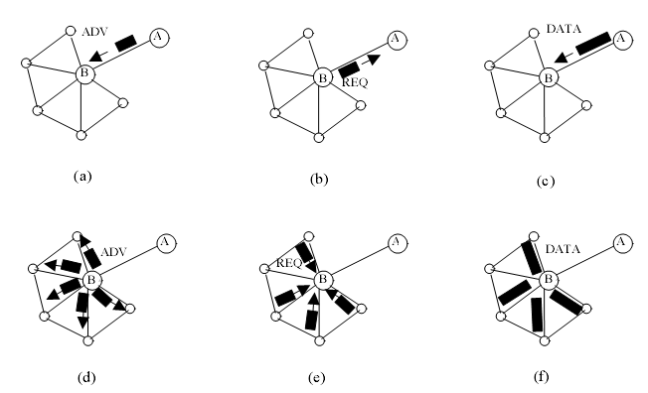
SPIN(2/3)
51

Slide 16
SPIN(3/3)
Topological changes are localized
provides more energy savings than flooding, and metadata negotiation almost halves the redundant data.
Drawback: SPIN’s data advertisement mechanism cannot guarantee delivery of data.
51

Slide 17
Flat-routing
SPIN (Sensor Protocols for Information via Negotiation)
DD (Directed diffusion)
Rumor routing
51

Slide 18
DD(1/3)[1]
Propagate interest
Set up gradients
Send data and path reinforcement
51
[1]C. Intanagonwiwat, R. Govindan, and D. Estrin, “Directed Diffusion: a Scalable and Robust Communication Paradigm for Sensor Networks,” Proc. ACM Mobi- Com 2000, Boston, MA, 2000, pp.56–67.

Slide 19
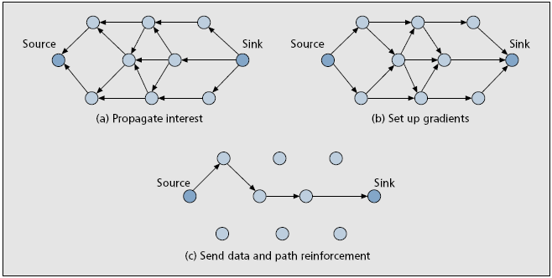
DD(2/3)
51

Slide 20
DD(3/3)
Directed diffusion differs from SPIN in two aspects.
  Query method
  Communication method
directed diffusion may not be applied to applications (e.g., environmental monitoring)
Matching data to queries might require some extra overhead
51

Slide 21
Flat-routing
SPIN (Sensor Protocols for Information via Negotiation)
DD (Directed diffusion)
Rumor routing
51

Slide 22
Rumor routing[1]
A variation of directed diffusion
Use an events table and a agent
The number of events is small and the number of queries is large
51
[1]D. Braginsky and D. Estrin, “Rumor Routing Algorithm for Sensor Networks,” Proc. 1st Wksp. Sensor Networks and Apps., Atlanta, GA, Oct. 2002.

Slide 23
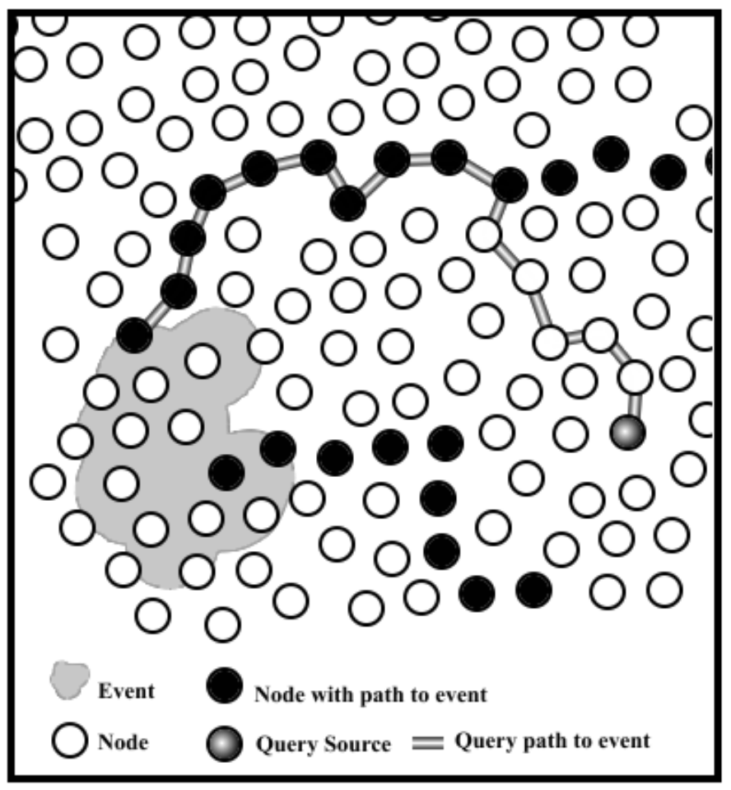
Rumor routing
51

Slide 24
Router protocol survey
Traditional routing technique
Flooding
Gossiping
Current routing technique
Flat-routing
Hierarchical-routing
Location-based routing
51

Slide 25
Hierarchical-routing
LEACH (Low Energy Adaptive Clustering Hierarchy)
PEGASIS (Power-Efficient Gathering in Sensor Information Systems)
TEEN(APTEEN) (Threshold-Sensitive Energy Efficient Protocols)
51

Slide 26
LEACH(1/3)[1]
LEACH is a cluster-based protocol
Setup phase
Steady state phase
[1]. Heinzelman, A. Chandrakasan and H. Balakrishnan, “Energy-Efficient Communication
Protocol for Wireless Microsensor Networks,” Proc. 33rd Hawaii Int’l. Conf. Sys. Sci., Jan. 2000.
51

Slide 27
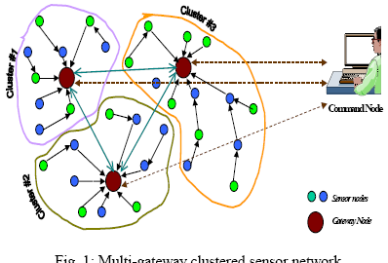
LEACH(2/3)
51

Slide 28
LEACH(3/3)[1]
Drawbacks
  It is not applicable to networks deployed in large regions
  The idea of dynamic clustering brings extra overhead
  The protocol assumes that all nodes begin with the same amount of energy capacity in each election round, assuming that being a CH consumes approximately the same amount of energy fore ach node
51

Slide 29
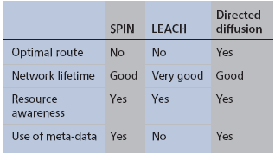
Comparison between SPIN LEACH and directed diffusion[1]
[1]W. Heinzelman, A. Chandrakasan and H. Balakrishnan, “Energy-Efficient Communication Protocol for Wireless Microsensor Networks,” Proc. 33rd Hawaii Int’l. Conf. Sys. Sci., Jan. 2000.
51

Slide 30
Hierarchical-routing
LEACH (Low Energy Adaptive Clustering Hierarchy)
PEGASIS (Power-Efficient Gathering in Sensor Information Systems)
TEEN(APTEEN) (Threshold-Sensitive Energy Efficient Protocols)
51

Slide 31
PEGASIS(1/2)[1]
An enhancement over the LEACH protocol is a near optimal chain-based protocol
increase the lifetime of each node by using collaborative techniques.
allow only local coordination between nodes and the bandwidth consumed in communication is reduced
[1]S. Lindsey and C. Raghavendra, “PEGASIS: Power-Efficient Gathering in Sensor Information Systems,” IEEE Aerospace Conf. Proc., 2002, vol. 3, 9–16, pp. 1125–30.
51

Slide 32
PEGASIS(2/2)
Drawbacks:
  assumes that each sensor node is able to communicate with the BS directly
  assumes that all sensor nodes have the same level of energy and are likely to die at the same time
  the single leader can become a bottleneck.
  excessive data delay
51

Slide 33
Comparison between PEGASIS and
SPIN
PEGASIS saving energy in several stages
    In the local gathering , the distance that node transmit
    The amount of data for CH head to receive
    Only one node transmits to BS
51

Slide 34
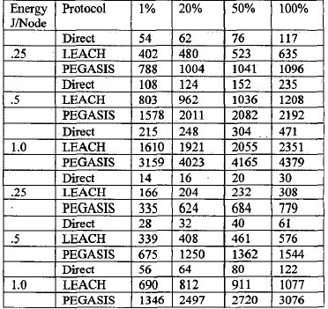
51

Slide 35
Hierarchical-routing
LEACH (Low Energy Adaptive Clustering Hierarchy)
PEGASIS (Power-Efficient Gathering in Sensor Information Systems)
TEEN (Threshold-Sensitive Energy Efficient Protocols)
51

Slide 36
TEEN[1]
TEEN’S CH sensor sends its members a hard threshold and a soft threshold.
TEEN’S suitability for time-critical sensing applications
TEEN is also quite efficient in terms of energy consumption and response time
TEEN also allows the user to control the energy consumption and accuracy to suit the application.
51
[1]A. Manjeshwar and D. P. Agarwal, “TEEN: a Routing Protocol for Enhanced Efficiency in Wireless Sensor Networks,” 1st Int’l. Wksp. on Parallel and Distrib. Comp. Issues in WirelessNetworks and Mobile Comp., April 2001.

Slide 37
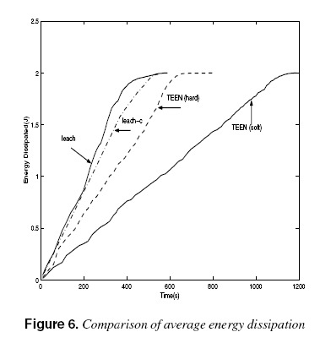
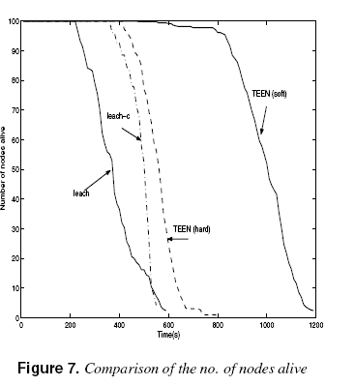
Comparison of between TEEN and LEACH
average energy dissipation(100nodes and 100*100units)
51

Slide 38
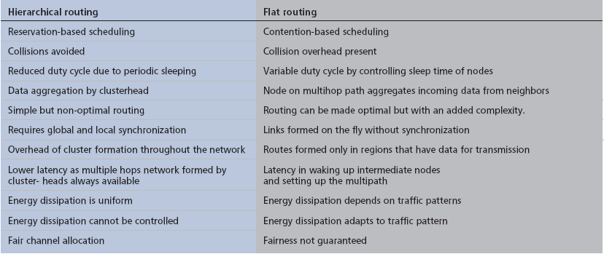
Hierarchical vs. flat topologies routing.[1]
[1]JAMAL N. AL-KARAKI, AHMED E. KAMAL,” ROUTING TECHNIQUES IN
WIRELESS SENSOR NETWORKS: A SURVEY”, IEEE Wireless Communications • December 2004
51

Slide 39
Router protocol survey
Traditional routing technique
  Flooding
  Gossiping
Current routing technique
  Flat-routing
  Hierarchical-routing
  Location-based routing
51

Slide 40
Location-based routing
GEAR (Geographic and Energy Aware Routing)
GEM
51

Slide 41
GEAR(1/3)[1]
The key idea is to restrict the number of interests in directed diffusion by only considering a certain region rather than sending the interests to the whole network.
keeps an estimated cost and a learning cost
51
[1]Y. Yu, D. Estrin, and R. Govindan, “Geographical and Energy-Aware Routing:A Recursive Data Dissemination Protocol
for Wireless Sensor Networks,” UCLA Comp. Sci. Dept. tech. rep., UCLA-CSD TR-010023, May 2001.

Slide 42
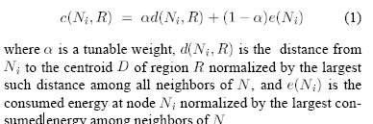
GEAR(2/3)
51

Slide 43
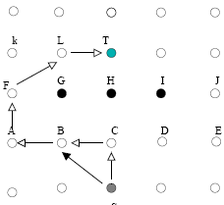
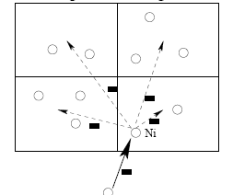
GEAR(3/3)
51

Slide 44
Comparison between GPSR and
GEAR
GPSR：designed for general mobile ad hoc networks
Two parameter
  Uniform Traffic
  Non-uniform Traffic
For uneven traffic distribution, GEAR delivers 70–80 percent more packets than GPSR. For uniform traffic pairs GEAR delivers 25–35 percent more packets than GPSR.
51

Slide 45
GEM(1/2)
Three type of storage data
  Local storage
  External storage
  Data-centric storage
Setup phase
  Set up a tree
  Feedback the number of tree
  Assign the virtual degree
51

Slide 46
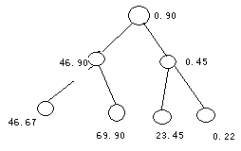
GEM(2/2)
The main application of relative steady topology sensor network
51

Slide 47
Conclusion
based on the network structure divide three categories: flat, hierarchical, and location-based routing protocols.
The advantages and disadvantages of each routing technique
In general hierarchical routing are outperform than flat routing
51

Slide 48
reference
I. Akyildiz et al., “A Survey on Sensor Networks,” IEEE Commun. Mag., vol. 40, no. 8, Aug. 2002, pp. 102–14.
W. Heinzelman, A. Chandrakasan and H. Balakrishnan,“Energy-Efficient Communication Protocol for Wireless Microsensor Networks,” Proc. 33rd Hawaii Int’l. Conf. Sys. Sci., Jan. 2000.
F. Ye et al., “A Two-Tier Data Dissemination Model for Large-Scale Wireless S. Hedetniemi and A. Liestman, “A Survey of Gossiping and broadcasting in Communication Networks,” IEEE Network, vol. 18, no. 4, 1988, pp. 319–49.
51

Slide 49
reference
C. Intanagonwiwat, R. Govindan, and D. Estrin, “Directed Diffusion: a Scalable and Robust Communication Paradigm for Sensor Networks,” Proc. ACM Mobi- Com 2000, Boston, MA, 2000, pp. 56–67.
D. Braginsky and D. Estrin, “Rumor Routing Algorithm for Sensor Networks,” Proc. 1st Wksp. Sensor Networks and Apps., Atlanta, GA, Oct. 2002.
C. Schurgers and M.B. Srivastava, “Energy Efficient Routing in Wireless Sensor Networks,” MILCOM Proc. Commun. for Network-Centric Ops.: Creating the Info. Force, McLean, VA, 2001.
M. Chu, H. Haussecker, and F. Zhao, “Scalable Information Driven Sensor Querying and Routing for Ad Hoc Heterogeneous Sensor Networks,” Int’l. J. High Perf. Comp. Apps., vol. 16, no. 3, Aug. 2002.
51

Slide 50
reference
Q. Li, J. Aslam and D. Rus, “Hierarchical Power-Aware Routing in Sensor Networks,” Proc. DIMACS Wksp. Pervasive Net., May, 2001.
Y. Xu, J. Heidemann, and D. Estrin, “Geographyinformed Energy Conservation for Ad-hoc Routing,” Proc. 7th Annual ACM/IEEE Int’l. Conf. Mobile Comp. and Net., 2001, pp. 70–84.
S. Lindsey and C. Raghavendra, “PEGASIS: Power-Efficient Gathering in Sensor Information Systems,” IEEE Aerospace Conf. Proc., 2002, vol. 3, 9–16, pp. 1125–30.
A. Manjeshwar<number> and D. P. Agarwal, “TEEN: a Routing Protocol for Enhanced Efficiency in Wireless Sensor Networks,” 1st Int’l. Wksp. on Parallel and Distrib. Comp. Issues in Wireless Networks and Mobile Comp., April 2001.
51

Slide 51
Thank You!
51

